Slide 1

UE20CS390A – Capstone Project Approval
Project Title : An Entity to 3D Model Prototype from a Photo.
Project ID : PW23_NVP_02
Project Guide : Prof. Nitin V Pujari
Project Team : Nikita S Patgar [PES1UG21CS825]
Ravallu Nikhil Rajareddy [PES1UG21C830]
Titeersha Ghatak Chowdhury [PES1UG21CS834]
Vaishnavi .K [PES1UG21CS838]

Slide 2
An Entity to 3D Model Prototype from a Photo
Outline
Problem Statement
Scope and Feasibility study
Applications/Use cases
Expected Deliverables
Capstone (Phase-I & Phase-II) Project Timeline
Any other information

Slide 3
An Entity to 3D Model Prototype from a Photo
Problem Statement
A 3D model prototype from a photo can be used for variety of purposes. However creating an accurate and visually appealing 3D model from a photo can be challenging due to number of factors which includes:
Inadequate image quality
Complexity of the image
Time constraints
Lack of technical skills

Slide 4
An Entity to 3D Model Prototype from a Photo
Problem Statement[contd..]
The implementation is to develop a deep learning-based system that utilizes convolutional neural networks [CNNs] to generate G-code commands for 3D printing, in order to produce a physical prototype of an object based on a single 2D image , capturing its geometry and appearance accurately.

Slide 5
An Entity to 3D Model Prototype from a Photo
Scope and Feasibility study
The scope of creating a 3D model prototype from a photo can encompass the following aspects:
Image Processing
3D Reconstruction
Material Simulation
G Code Generation
Prototype Printing
Post-Printing Processing

Slide 6
An Entity to 3D Model Prototype from a Photo
Scope and Feasibility study[contd..]
A feasibility study for creating a 3D model prototype from a photo involves evaluating the technical, operational, and financial aspects of the project to determine its viability. The following are some key elements of a feasibility study for this project:
Technical Feasibility.
Operational Feasibility.
Financial Feasibility.
Market Feasibility.

Slide 7
An Entity to 3D Model Prototype from a Photo
3D Prototype
3D prototyping is a process of creating a three-dimensional (3D) model of a product, part, or assembly, using computer-aided design (CAD) software, 3D printing, or other advanced manufacturing techniques. The purpose of 3D prototyping is to test and validate the design, form, and function of a product before committing to full-scale production.
2532,2535,2784,2861
8

Slide 8

An Entity to 3D Model Prototype from a Photo
Implementation
Our projects starts with an application saying either to select image from-
Camera
(or)
Upload an image
8
2532,2535,2784,2861

Slide 9

An Entity to 3D Model Prototype from a Photo
Implementation
The uploaded image is given to the trained machine to detect and recognize the faces and objects.
The faces or objects detected to be bounded by a frame ,recognizing the objects and human faces,which will be trained prior.
2532,2535,2784,2861
8

Slide 10

An Entity to 3D Model Prototype from a Photo
Implementation
The recognized faces and objects need to be tagged as to maintain the uniqueness.
There comes an option of selecting
Auto tag
(or)
User defined tag
2532,2535,2784,2861
8

Slide 11
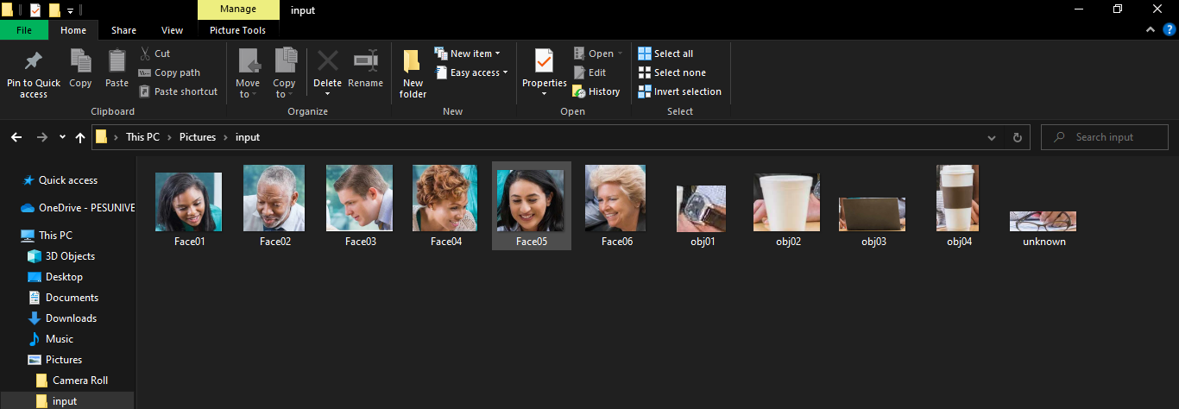
An Entity to 3D Model Prototype from a Photo
Implementation
Identified and tagged images are to be extracted to a file which will be an input for the next phase.
2532,2535,2784,2861
8

Slide 12
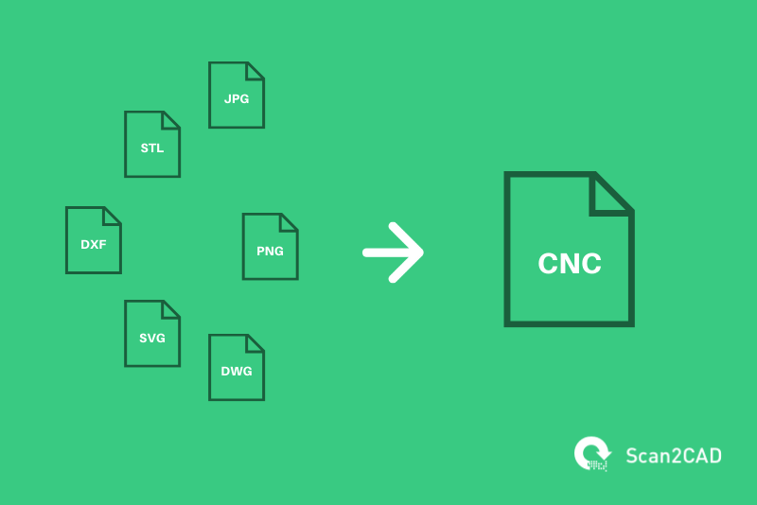

An Entity to 3D Model Prototype from a Photo
Implementation
Irrespective of image format the extracted images are converted into G-code. Which is an code given to the 3D printer as an input to get the expected 3D model.
2532,2535,2784,2861
8

Slide 13

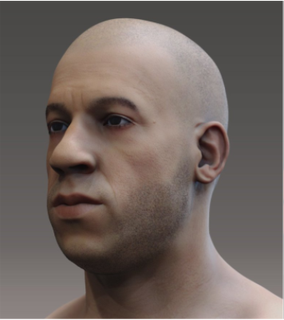
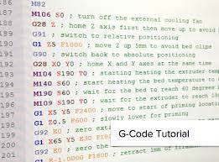
An Entity to 3D Model Prototype from a Photo
Implementation
This is how the whole process works in conversion of an 2D plane image to an 3D model. Where we are able to achieve the G-code which is desired for creating an 3D model.
2532,2535,2784,2861
8

Slide 14

An Entity to 3D Model Prototype from a Photo
Applications/Use Cases
The applications of creating a 3D model prototype from a photo include:
Architecture and construction
Film and gaming
Cultural heritage preservation
Product design and prototyping
Virtual and augmented reality

Slide 15
An Entity to 3D Model Prototype from a Photo
Expected Deliverables
A 3D model of the face
G code file
User interface
Performance metrics
Validation
Documentation

Slide 16
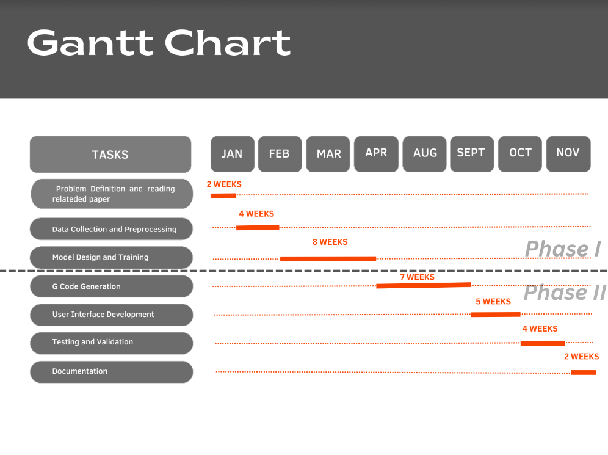
An Entity to 3D Model Prototype from a Photo
Capstone (Phase-I & Phase-II) Project Timeline

Slide 17
An Entity to 3D Model Prototype from a Photo
Any other information
3D Scanning
3D Modeling Techniques
Texturing and Materials
Animation and Rigging

Slide 18
An Entity to 3D Model Prototype from a Photo
References
https://machinelearningmastery.com/how-to-perform-face-detection-with-classical-and-deep-learning-methods-in-python-with-keras/
https://towardsdatascience.com/detecting-facial-features-using-deep-learning-2e23c8660a7a
https://www.researchgate.net/publication/337465633_Design_Implementation_and_Analysis_of_a_Low_Cost_Drawing_Bot_for_Educational_Purpose
https://www.researchgate.net/publication/331688882_G-code_Modeling_for_3D_Printer_Quality_Assessment

Slide 19
An Entity to 3D Model Prototype from a Photo
Conclusion
The conclusion for creating a 3D model prototype from a photo would depend on the specific process and the results obtained. However, in general, the process of converting a photo into a 3D model typically involves the use of computer vision and 3D modeling techniques to extract features from the image, create a 3D mesh, and add textures and materials to create a realistic representation of the object in the photo. The success of the process depends on several factors, such as the quality of the photo, the complexity of the object, and the expertise of the person performing the conversion.

Slide 20
Thank You

